Slide 1
AI based motion control trajectory-based motion control
1.7 Jin Lexuan

Slide 2
The reason of trajectory-based motion control
1. path-based path replanning not always works:
the space may be narrow because of obstacles, where path is difficult to replan.
if one path changed, it will affact other path. In some extreme situation, we have to replan all the path,when the number of UAVs is large(e.g. 10). The calculation quantity will also be large.
2.time is easier to control and can make full use of the space.

Slide 3
Step of trajectory-based motion control
1.path plan and trajectory calculation for 2 UAVs
(since get trajectory, means for each UAV, its location of each second is known.)
2.For every second, calculate the distance of two UAVs
3.if the distance is larger that the set collision circle
no collision, keep two trajectory
else:
high priority UAV keeps original trajectory, replan trajectory of lower priority UAV: slow down the velocity of low priority UAV, make sure in new trajectory, it pass the collison point when high priority UAV passed

Slide 4
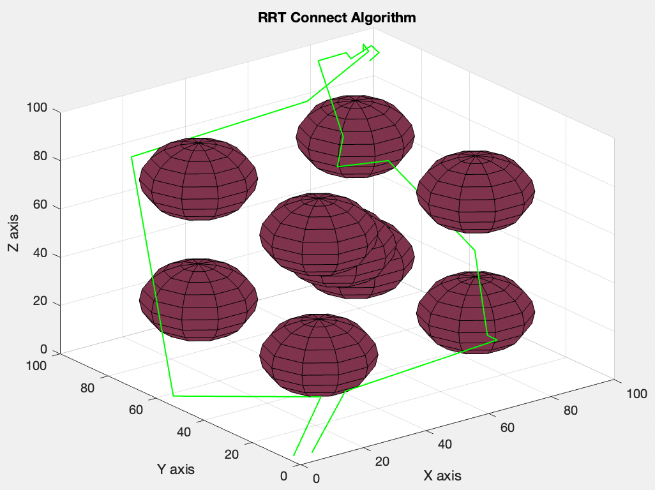
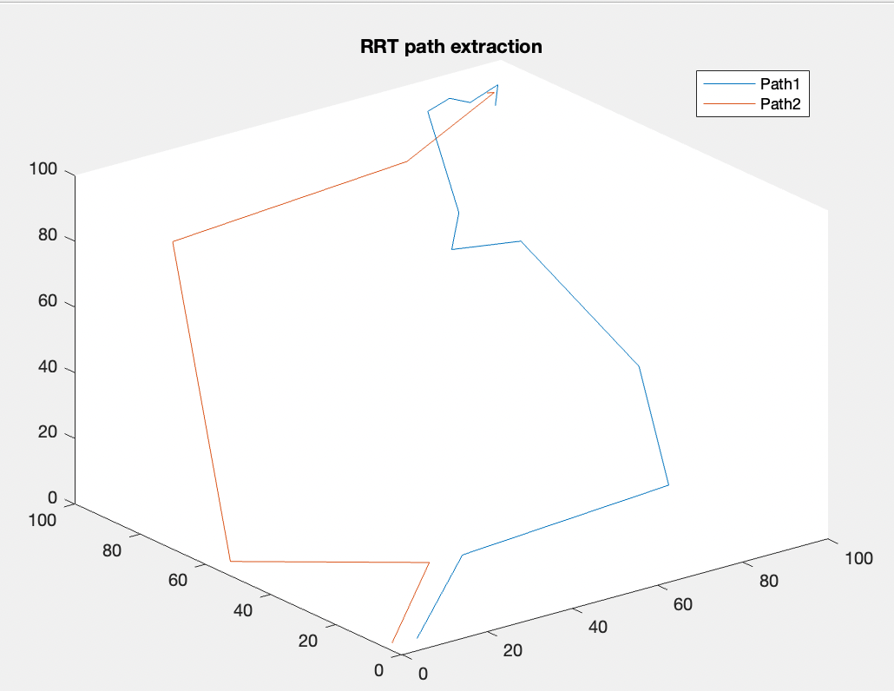
RRT planned path

Slide 5
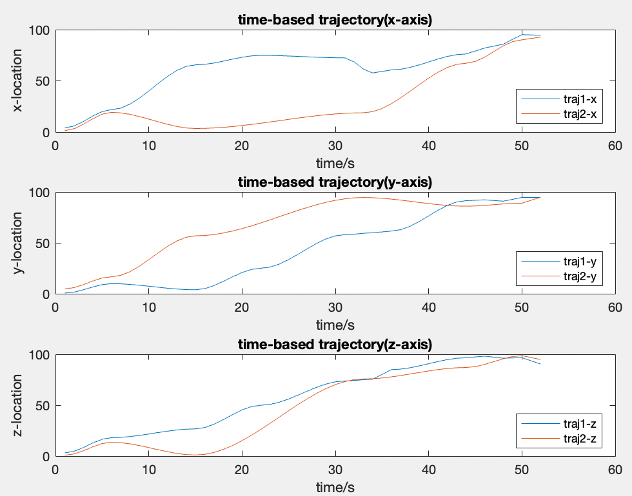
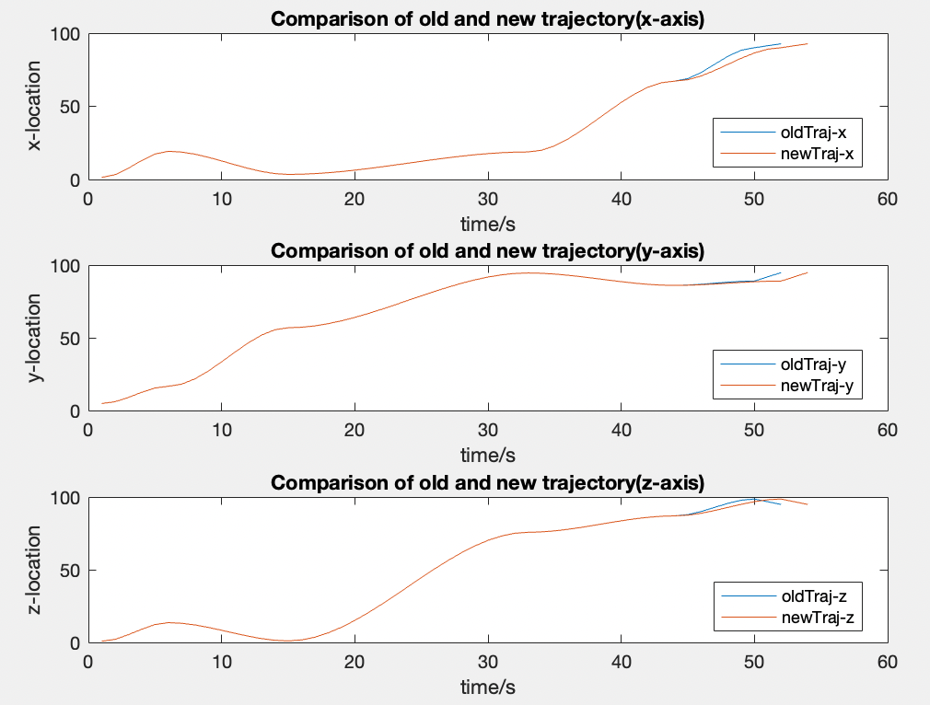
Time-based trajectory
the collision detection part shows that collision may happen at 48,49,52second
trajectory1 and trajectory2
new and old trajectory1

Slide 6
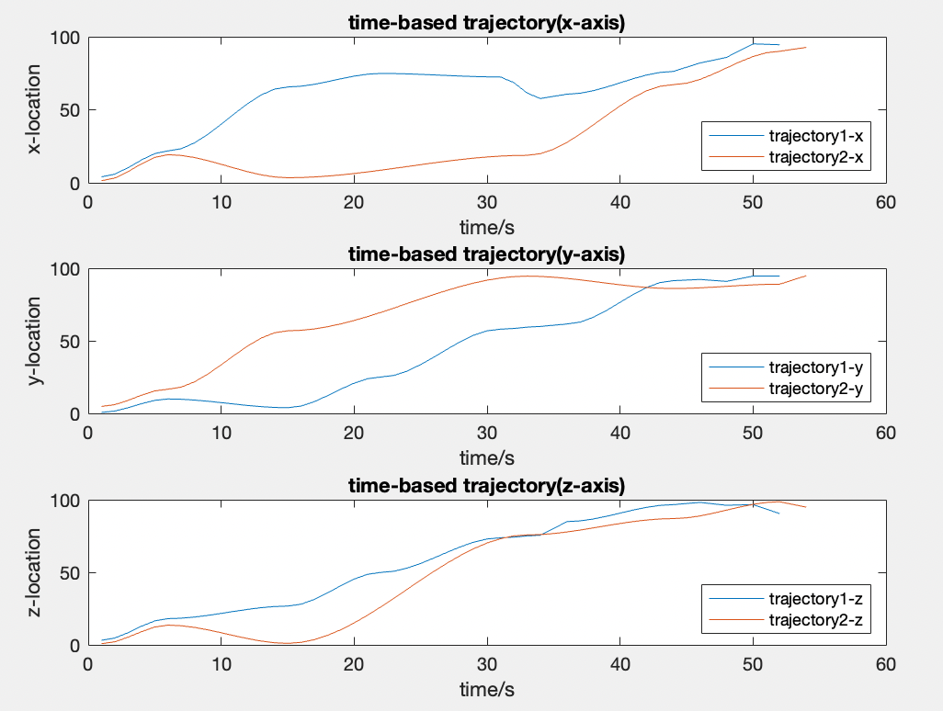
Comparison of old and new trajectory
trajectory1 and old trajectory2
trajectory1 and new trajectory2

Slide 7
Preparation for multi-UAVs
To study the performance of more UAVs:
I change the structure of program, only to change the number of UAVs, then it can generate RRT path and time-based trajectory accordingly
Then according to the generated path, trajectory-based(time-based) motion control will be conducted.

Slide 8
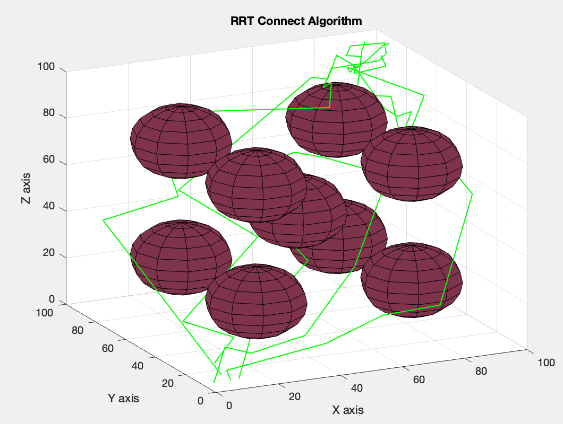
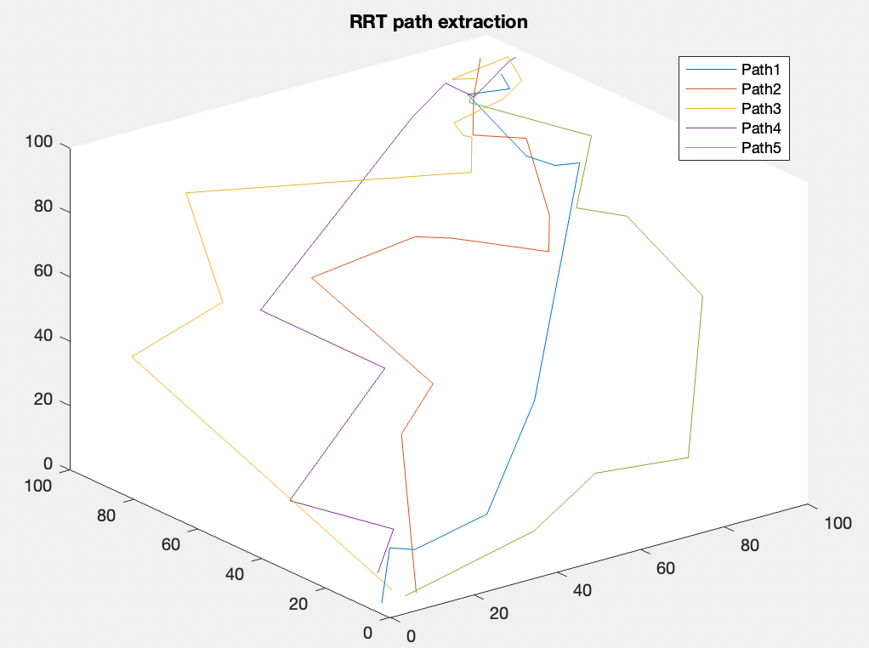
RRT path planning and extraction for multi-UAVs

Slide 9
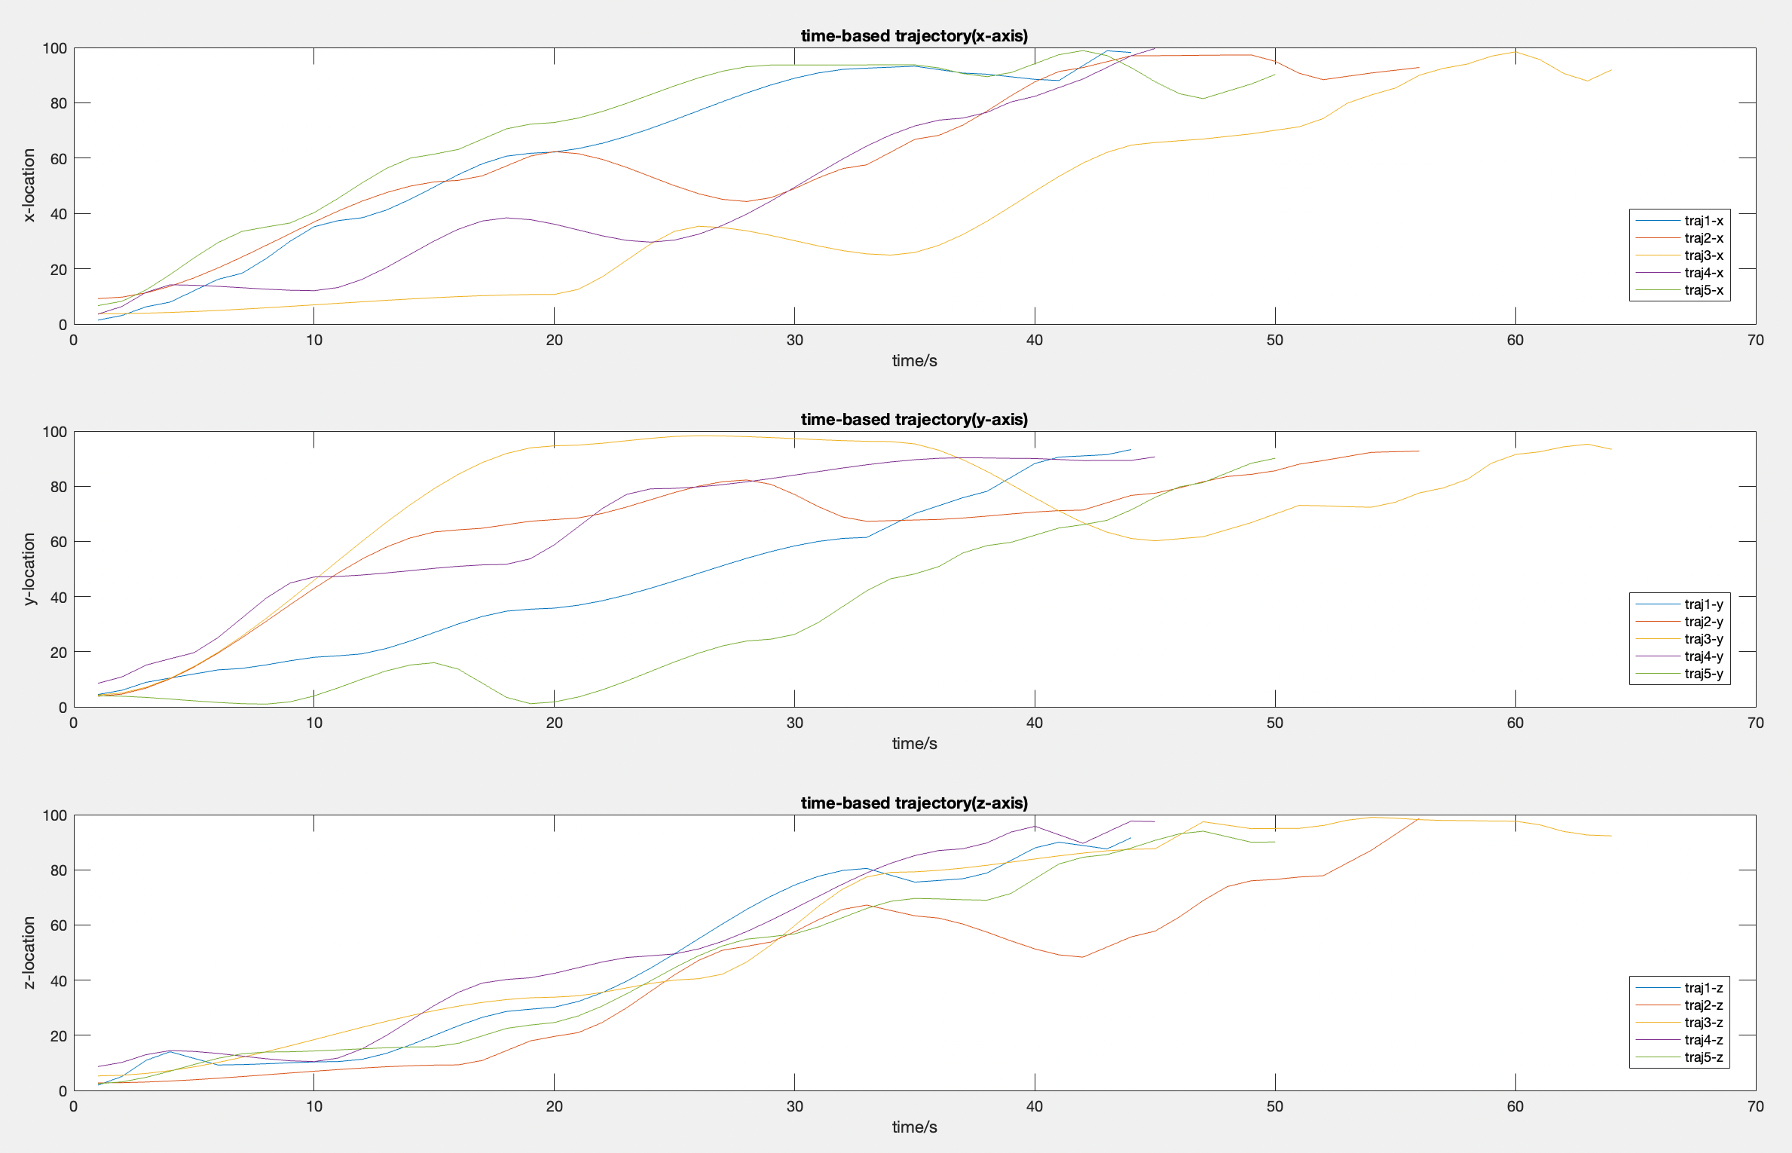
Visualization for time-based trajectory(multi-UAVs)
I will do the same thing to these five trajectory as I did to 2 trajectory

